Slide 1

Introduction to Deep Learning
Lecture 1

Slide 2
AI is intelligence demonstrated by machines, as opposed to natural intelligence displayed by animals including humans.
Artificial Intelligence (AI), Machine Learning (ML), and Deep Learning (DL)
ML is the study of computer algorithms that can improve automatically through experience and using data. It is seen as a part of artificial intelligence.
DL is part of a broader family of machine learning methods based on artificial neural networks.
( Source: Wikipedia)

Slide 3



Relationship of AI, ML and DL
Artificial Intelligence (AI) is anything about man-made intelligence exhibited by machines.
Machine Learning (ML) is an approach to achieve AI.
Deep Learning (DL) is one technique to implement ML.
Artificial Intelligence
Machine Learning
Deep Learning

Slide 4
Types of ML Algorithms
Supervised Learning
trained with labeled data; including regression and classification problems
Unsupervised Learning
trained with unlabeled data; clustering and association rule learning problems.
Reinforcement Learning
no training data; stochastic Markov decision process; robotics and self-driving cars.
Machine Learning
 | Supervised Learning
 | Unsupervised Learning
 | Reinforcement Learning

Slide 5
What is Deep Learning?
Deep learning is a subset of machine learning that utilizes artificial neural networks to analyze data and make predictions. These networks, inspired by the human brain, consist of multiple layers that learn from large datasets and can automatically extract features, analyze data in real time, and reveal hidden insights.
(Source: Wikipedia)

Slide 6
Why Deep Learning?
Limitations of traditional machine learning algorithms
not good at handling high dimensional data.
difficult to do feature extraction and object recognition.
Advantages of deep learning
DL is computationally expensive, but it is capable of handling high dimensional data.
feature extraction is done automatically.

Slide 7
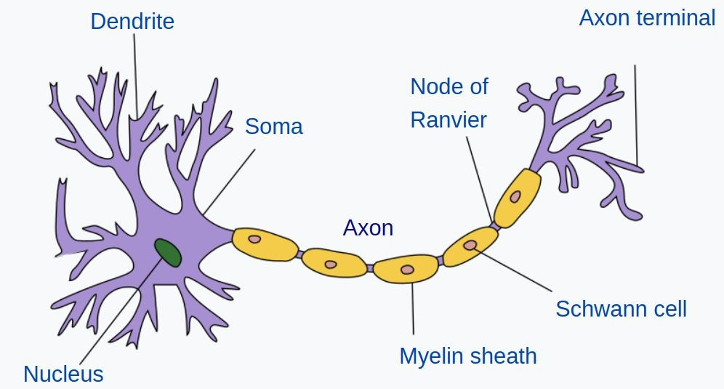


Artificial Neural Network
Input
Hidden Layers
Output
(Image Credit: Wikipedia)

